Slide 1
“Nuclear Power Generation”
By
Professor Dr. Khokon Hossen
Department of Physics
Patuakhali Science and Technology University
Dumki, Patuakhali-8602
Bangladesh.

Slide 2
Contents
Introduction
Fission Reactions
Important Characteristics of Fission Reactions
Controlled Fission Reactions
Technology of Nuclear Power Plants
How Nuclear Power Plant Works?
Advantages
Disadvantages
Conclusions

Slide 3
Introduction
Nuclear power is energy which is produced with the use of a controlled nuclear reaction.
Nuclear power plants provide about 6% of the world's energy and 13–14% of the world's electricity with the U.S.A France and Japan together accounting for about 50% of nuclear generated electricity

Slide 4
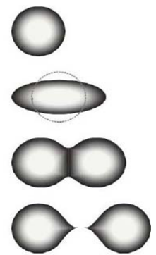
Fission Reactions
Fission may be defined as the process of splitting an atomic nucleus into fission fragments
The fission fragments are generally in the form of smaller atomic nuclei and neutrons
Large amounts of energy are produced by the fission process

Slide 5
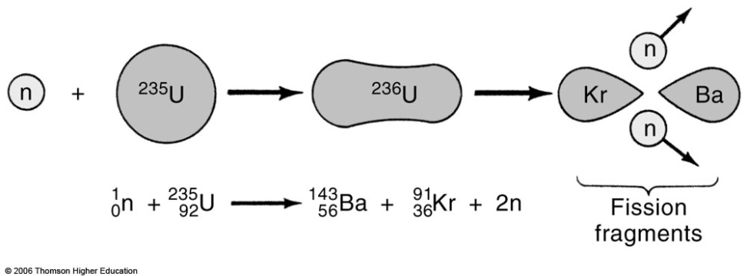
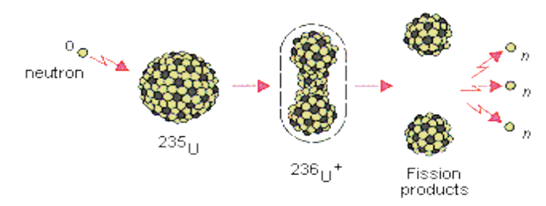
Fission Reactions

Slide 6
Fission Reactions
Some Examples of Fission Reactions
²³⁵₉₂U + ¹₀n →¹⁴¹₅₆Ba + ⁹²₃₆Kr + 3 ¹₀n +Energy
²³⁵₉₂U + ¹₀n →¹³¹₅₀Sn + ¹⁰³₄₂Mo + 2 ¹₀n +Energy ²³⁵₉₂U + ¹₀n→ ¹³⁷₅₂Te + ⁹⁷₄₀Zr + 2 ¹₀n +Energy
²³⁵₉₂^{U} + ¹₀n →¹³⁸₅₄Xe + ⁹⁵₃₈Sr + 3 ¹₀n +Energy
²³⁵₉₂U + ¹₀n→¹⁵²₆₀Nd + ⁸¹₃₂Ge + 3 ¹₀n +Energy

Slide 7
Fission Reactions There are two types of fission reaction exist as:
(i) Spontaneous Fission
Spontaneous fission is a naturally occurring nuclear decay event that a few different elements undergo
Uranium and plutonium, which are radioactive, are the most well known of the fissionable elements, and they can do this in nature
(ii)Induced Fission
Nuclear fission can be induced by bombarding atoms with neutrons.
The nuclei of the atoms then split into 2 equal parts.
Induced fission decays are also accompanied by the release of neutrons.

Slide 8
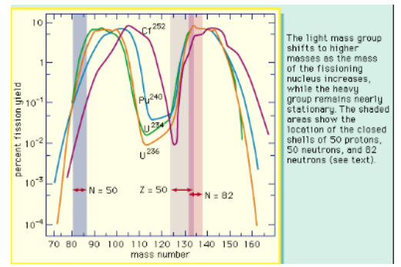
Important Characteristics of Fission Reactions Mass Distribution of Fragments

Slide 9
Important Characteristics of Fission Reactions Mass Distribution of Fragments
Fission fragments have a double bell distribution as a function of A (Mass Number).
Note that they are unstable, as are neutron rich they decay towards stable nuclei by a chain of beta decays.
This yields the so called “fission products”.

Slide 10
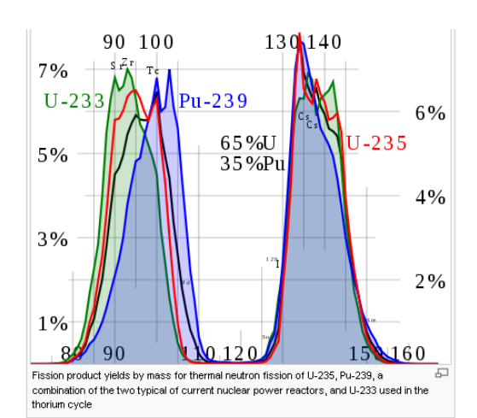
Important Characteristics of Fission Reactions Mass Distribution of Fragments

Slide 11
Important Characteristics of Fission Reactions Mass Distribution of Fragments
Fission product yields by mass for thermal neutron fission of ²³⁵U, ²³⁹Pu, a combination of the two typical of current nuclear power reactors, and ²³³U used in the thorium cycle.

Slide 12
Number of Emitted Neutrons
(i) Prompt Neutrons: They are those accompanying the two nuclear fragments as the 2n in
²³⁵U+n→ ⁹³Rb + ¹⁴¹Cs+2n
In the case of ²³⁵U, there are on the average 2.42 prompt neutrons
(ii) Delayed Neutrons: These are associated with the beta decay of the fission products. Delayed neutrons are essential for the control of nuclear reactors.

Slide 13
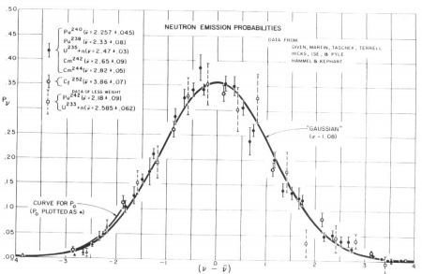
Number of Emitted Neutrons

Slide 14
Number of Emitted Neutrons
Distribution of fission neutrons.
Even though the average number of neutrons ν changes with the fissioning nucleus.
The distribution about the average is independent of the original nucleus.

Slide 15
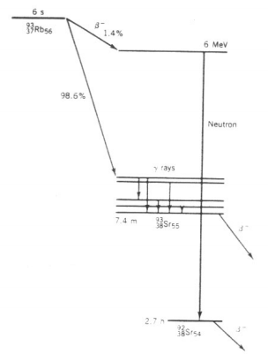
Number of Emitted Neutrons Delayed Neutron Emission from ⁹³Rb(Rubidium)

Slide 16
Number of Emitted Neutrons Delayed Neutron Emission from ⁹³Rb(Rubidium)
Delayed Neutron Emission from ⁹³Rb.
After the original β decay, the excited state of ⁹³Sr has enough
energy to decay by neutron emission to ⁹²Sr(Strontium).
The neutrons are delayed relative to the prompt fission neutrons by a time characteristic of the mean lifetime of ⁹³Rb

Slide 17

Radioactive Decay Processes
The initial fission products are highly radioactive and decay toward stable isobars by emitting many β and γ radiations(which contribute ultimately to the total energy release in fission).
These radioactive products are the waste products of nuclear reactors.

Slide 18
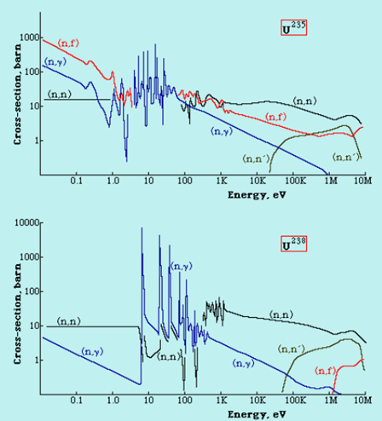
Fission Cross-section

Slide 19
Fission Cross-section
²³⁵U will fission (n,f) at all energies of the absorbed neutron.
²³⁵U fission cross section can grow Very large, to 500 barns sat thermal energies
²³⁸U has a threshold for fission (n, f) at a neutron energy of 1 MeV
There is very strong resonant capture of neutrons (n, γ) for energies in the range 10-100 eV - particularly in the case of 238U where the cross-section reaches very high values.

Slide 20
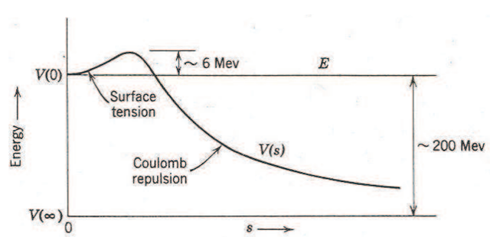
Energy in Fission
The excitation energy is
E_{ex} = [m (²³⁶U*) –m (²³⁶U)] c² = 931.50 MeV/u = 6.5 MeV
The activation energy =6.2 MeV

Slide 21
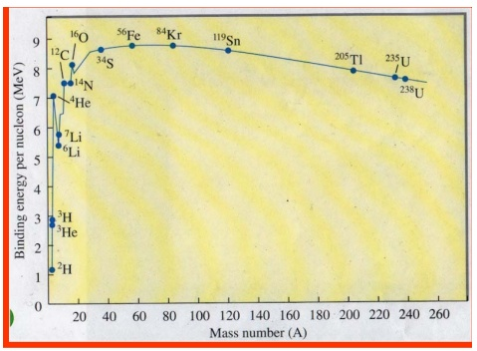
Energy in Fission
Binding energy for a nucleus ^{A}_{Z}X is Q (Z,N)=[Zm_{p} +Nm_{n} − m(^{A}_{Z}X)]c²
Typical Fission events Release 200 MeV
For ²³⁵U: ~235 MeV

Slide 22
Controlled Fission Reactions
Nuclear power plants work by controlling the rate of the nuclear reactions and that control is maintained through several safety measures.
The materials in a nuclear reactor core and the uranium enrichment level make a nuclear explosion impossible, even if all safety measures failed.
On the other hand, nuclear weapons are engineered to produce a reaction that is so fast and intense it cannot be controlled after it has started. When properly designed, this uncontrolled reaction can lead to an explosive energy release.

Slide 23
Controlled Fission Reactions Neutron Multiplication factor(k)
The effective neutron multiplication factor, k, is the average number of neutrons from one fission that causes fission:
k=(Number of Neutrons in one generation)/ (Number of neutrons in preceding generation)
The remaining neutrons either are absorbed in non-fission reactions or leave the system
without being absorbed.

Slide 24
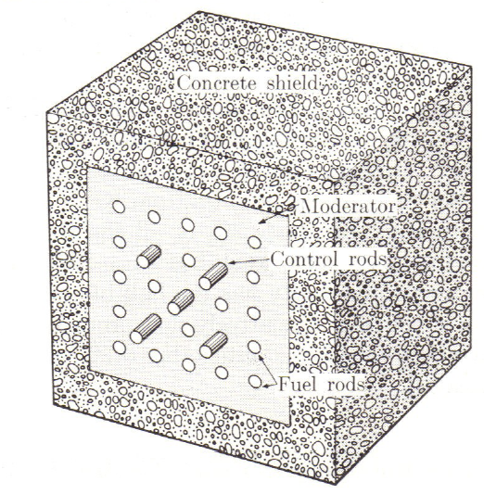
Controlled Fission Reactions Neutron Multiplication factor(k)
The value of k determines how a nuclear chain reaction proceeds.
k ≥ 1  Chain reaction
k < 1  subcritical
k = 1  critical system
k > 1  supercritical
For steady release of energy (steady- state operation) we need k =1
Chain reacting pile

Slide 25
Controlled Fission Reactions Four –factors formula
Neutron multiplication factor in an infinite medium k∞
k∞=ηfpɛ (Four-factor formula)
η- reproduction factor - the number of fission neutrons produced per absorption in the fuel
f - the thermal utilization factor - probability that a neutron that gets absorbed does so in the fuel material
p - the resonance escape probability - fraction of fission neutrons that manage to slow down from fission to thermal energies without being absorbed
ɛ- the fast fission factor = (Total Number of fission neutrons)/(Number of fission neutrons from just thermal fission)

Slide 26
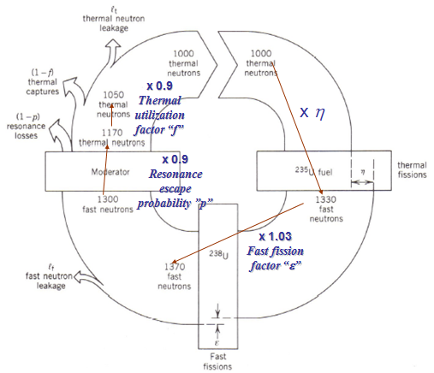
Controlled Fission Reactions Four –factors formula

Slide 27
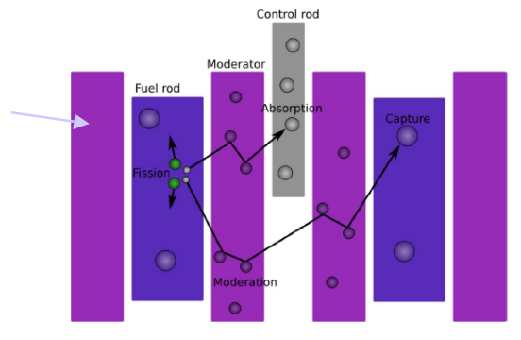
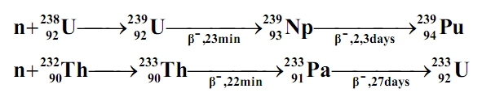
Fuel Use in the Reactor
In nature there are only 3 isotopes - ²³⁵U, ²³⁸U and ²³²Th –which can be used as nuclear fuel (²³⁵U) or reproduction of fuel (as ²³⁸U →239Pu; ²³²Th →²³³U ). Naturally occurring uranium consists 99.3% of ²³⁸U and only 0.7% of ²³⁵U i.e. for 1 nucleus of ²³⁵U there are 140 nuclei of ²³⁸U.

Slide 28
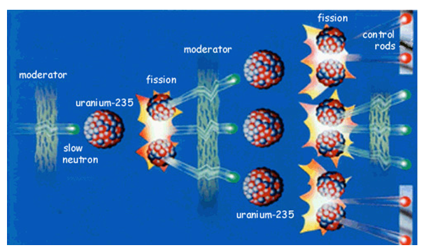
Moderator
In nuclear reactors there are neutron moderators, which reduce the velocity of fast neutrons, thereby turning them into thermal neutrons.
The following substances are commonly used as moderators.
graphite,
H₂O, D₂O
He
Be (high temperature liquid metal).
Na (773 to 873 K used in breeder reactor)
BeF₂ + ZrF₄ (for GCR)

Slide 29

Absorber
A control rod is a rod made of chemical elements capable of absorbing many neutrons without fissioning themselves. They are used in nuclear reactors to control the rate of fission of uranium and plutonium.
Usually, Cadmium, Boron, Carbon, Cobalt, Silver, Hafnium, Gadolinium and Europium are common elements used in control rods.

Slide 30
Technology of Nuclear Power Plants
Nuclear Power Plant
In a nuclear power plant use is made of the fission reaction. Most power plants produce electricity by first boiling water to produce steam. The steam is used to spin a turbine. The shaft of the turbine spins the generator (a large coil of wire) between two magnets. The spinning coil of wire generates electricity by electromagnetic induction.

Slide 31
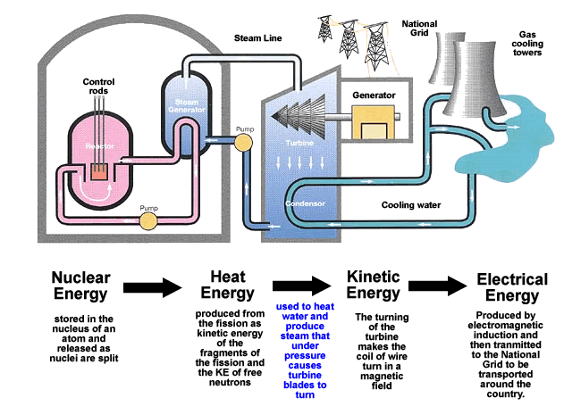
Nuclear Power Plant
The whole arrangement can be divided into following main stages.
(i)Nuclear Reactor
(ii) Heat Exchanger
(iii)Steam Turbine
(iv) Alternator

Slide 32
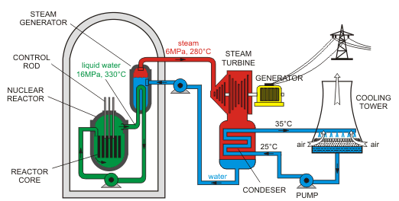
Nuclear Reactor Essential Components and types of a Nuclear Reactor
The core of the reactor contains all of the nuclear fuel and generates all of the heat.
The coolant is the material that passes through the core, transferring the heat from the fuel to a turbine.
The turbine transfers the heat from the coolant to electricity, just like in a fossil-fuel plant.
The containment is the structure that separates the reactor from the environment.
Cooling towers are needed by some plants to dump the excess heat that cannot be converted to energy due to the laws of thermodynamics.

Slide 33
Types of Nuclear Reactors
There are very many different types of nuclear reactors with different fuels, coolants, fuel cycles, purposes.
Pressurized Water Reactor
Boiling Water Reactor
Sodium Cooled Fast Reactor
Canada Deuterium-Uranium Reactors (CANDU)
Liquid Fluoride Thorium Reactor
High Temperature Gas Cooled Reactor

Slide 34
How Nuclear Power Plant Works
First, uranium fuel is loaded up into the reactor.
Control rods made of materials such as cadmium and boron can be raised or lowered into the reactor to soak up neutrons and slow down or speed up the chain reaction.
Water is pumped through the reactor to collect the heat energy that the chain reaction produces.

Slide 35
How Nuclear Power Plant Works
Inside the heat exchanger, the water from the reactor gives up its energy to cooler water flowing in another closed loop, turning it into steam.
The steam from the heat exchanger is piped to a turbine. As the steam blows past the turbine’s vanes, they spin around at high speed.
The spinning turbine is connected to an electricity generator and makes that spin too.
The generator produces electricity that flows out to the power grid.

Slide 36
Advantages of Nuclear Power
Nuclear electricity is reliable and relatively cheap (with an average generating cost of 2.9 cents per kW/h) once the reactor is in place and operating.
A lot of energy is generated from a single power plant
Nuclear power plants contribute no greenhouse gasses and few atmospheric pollutants

Slide 37
Disadvantages of Nuclear Power
Uranium is ultimately a nonrenewable resource.
Nuclear power plants are extremely costly to build.
The slight possibility that nuclear power plants can have catastrophic failures.
Large environmental impact during the mining and processing stages of uranium are numerous.
Nuclear waste (Spent nuclear fuel) is extremely hazardous and must be stored safely for thousands of years.

Slide 38
Conclusions
Nuclear power is a clean, safe, affordable way to meet future power demands in the all around the world.
It emits virtually no greenhouse gases (GHG), making it a clean power source that can help address global warming.
Nuclear power plants can produce an uninterrupted flow of electricity for extended periods.
To establish a nuclear power plant, we have to take more cautious for the following important issues.

Slide 39
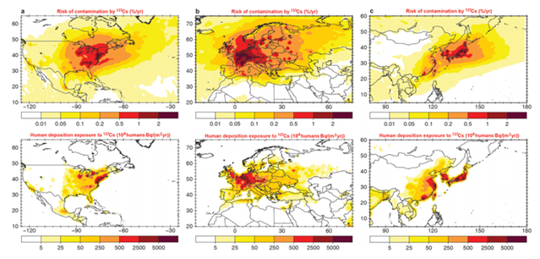
Conclusions
Environmental Impacts
Waste Management’s:
Sustainability
Accidents

Slide 40
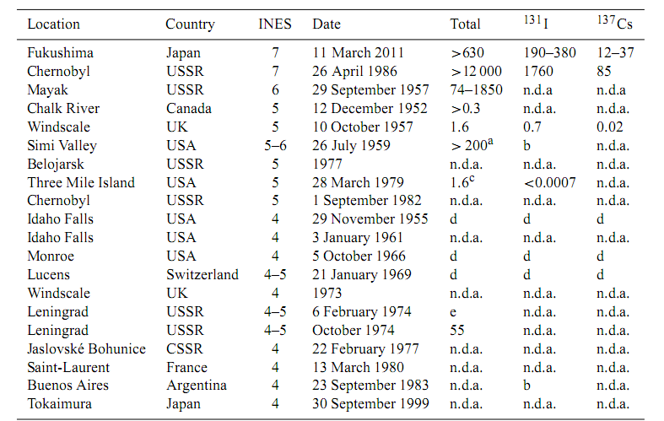
Conclusions

Slide 41
Bibliography
1. Introductory Nuclear Physics, Kenneth S. Krane
2. Key World Energy Statistics 2007. International Energy Agency. 2007. Retrieved 2008-06-21.
3. "Nuclear Power Plants Information. Number of Reactors Operation Worldwide". International Atomic Energy Agency. Retrieved 2008-06-21.
4. "World Nuclear Power Reactors 2007-08 and Uranium Requirements". World Nuclear Association. 2008-06-09. Archived from the original on March 3, 2008. Retrieved 2008-06-21.
5. Union-Tribune Editorial Board (March 27, 2011). "The nuclear controversy". Union-Tribune.

Slide 42
Thanks a lot
For your Attention!

